Slide 1
1U –X Mounting Drawings

Slide 2
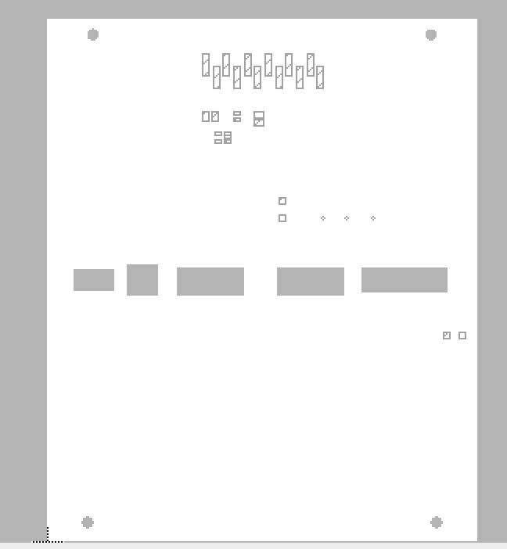
Top 3D

Slide 3
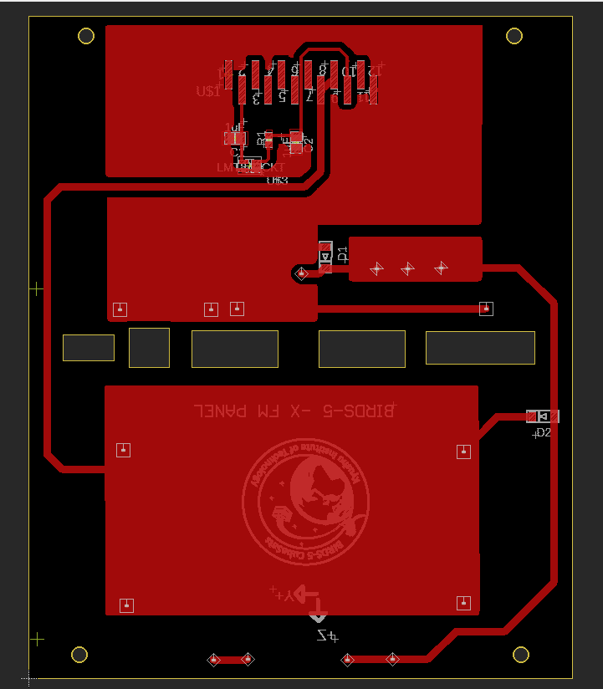
Top Solder

